Slide 1
Dose Response Curve Classification Model
Team Curveball Capstone Project
Sinéad Dunphy, Rohit Duvadie, Alyson Fay

Slide 2
Introduction
In cancer drug discovery, chemical compounds are screened on cancer cell lines in varying concentrations to determine if the cell lines show sensitivity to a compound
The response of a cell line to increasing doses of a compound can be visualized in a dose response curve
Researchers identify promising drug candidates by screening large numbers of compounds against a variety of cell lines and then analyzing the resulting curves
A large scale screen can result in millions of datapoints and hundreds of thousands curves that need to be evaluated.
Manually reviewing the curves can be burdensome

Slide 3
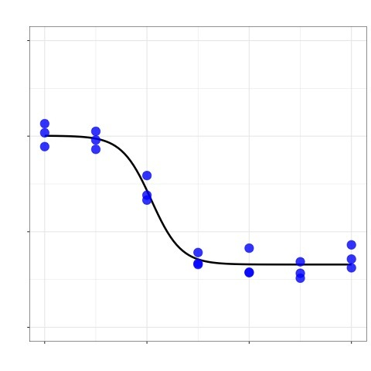
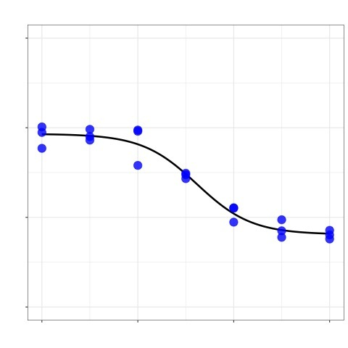
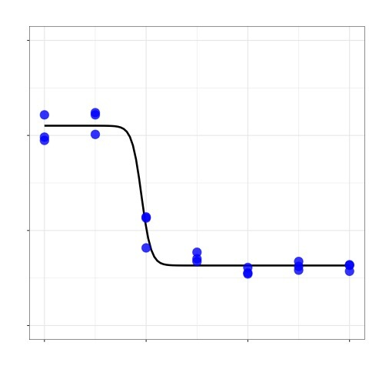
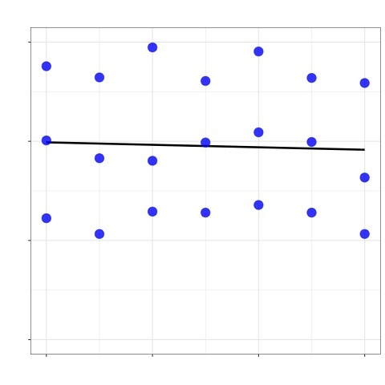
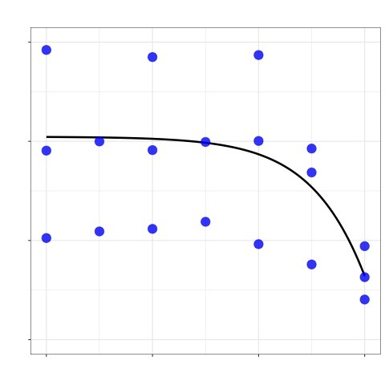
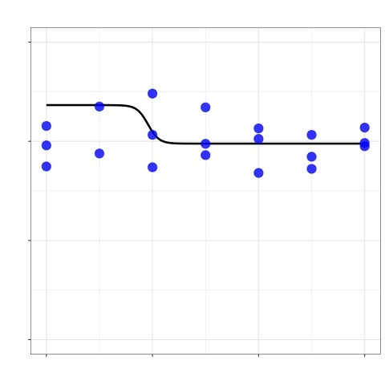
Dose response curves vary in quality
Good quality dose response curves
Important metrics to note
Slope of the curve
Maximum cell viability
Minimum cell viability
Standard deviation of datapoints
IC50
Upper limit of curve
Lower limit of curve
Cell Viability
Poor quality dose response curves
Goal
Develop an image-based machine learning algorithm that can classify the quality of dose response curves.
Drug Concentration

Slide 4
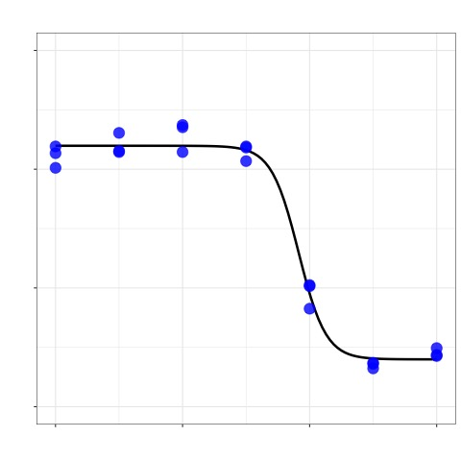
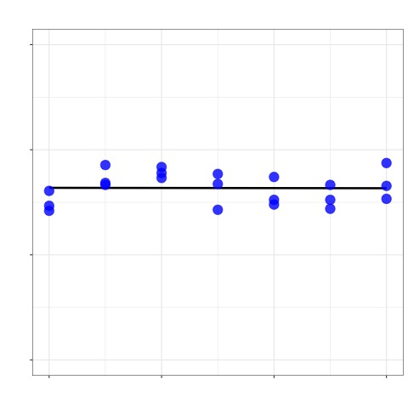
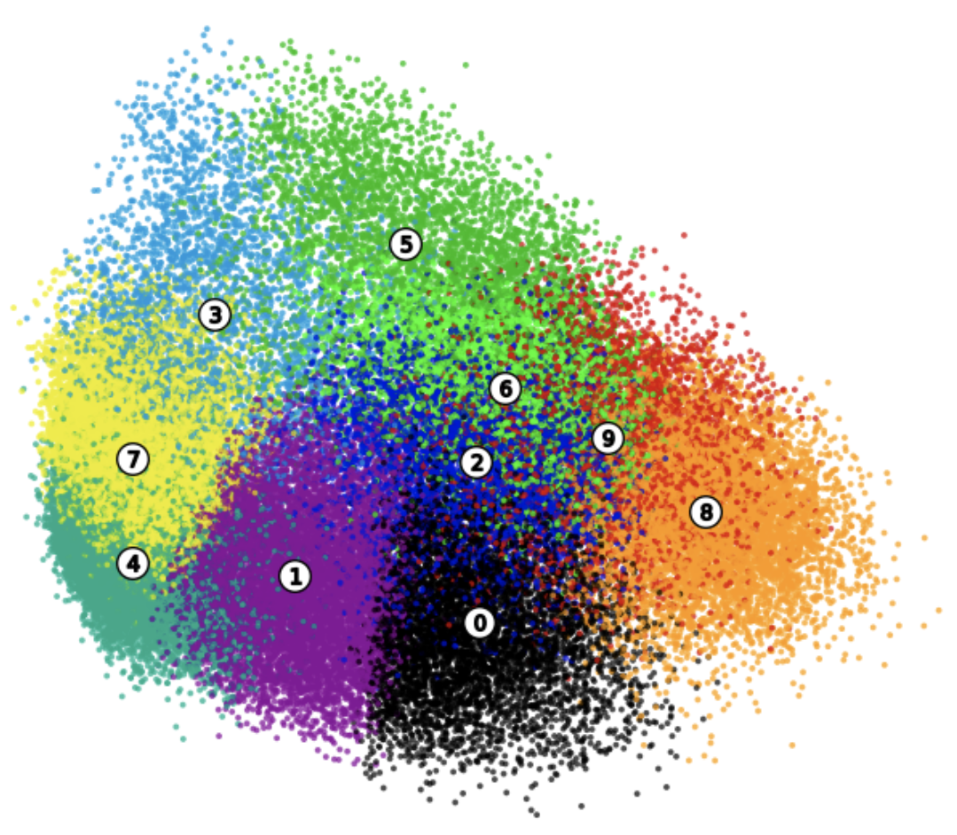
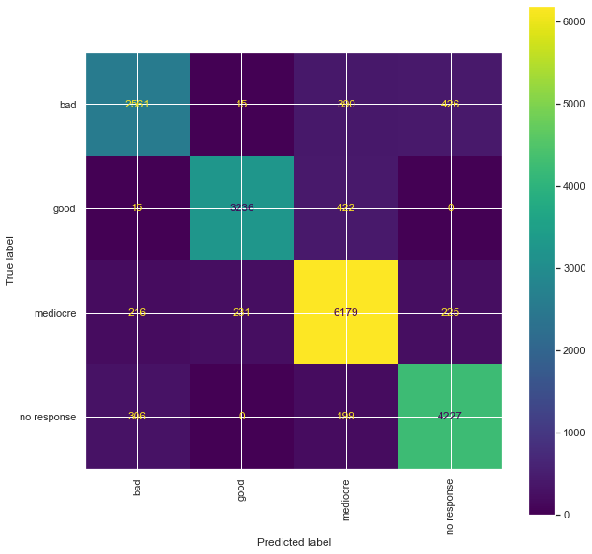
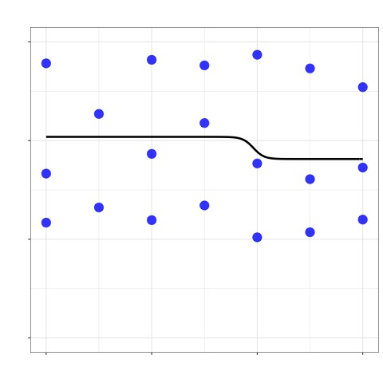
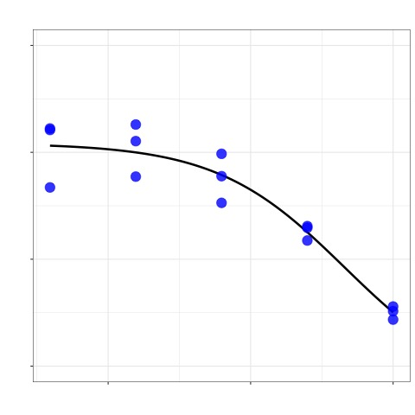
Project flowchart
Manually review obtained clusters and assign labels for curve quality
With these labels, train supervised model capable of classifying dose response curves by their quality
Use unsupervised learning to cluster dose curves based on visual similarity
Produce a dataset of dose response images

Slide 5
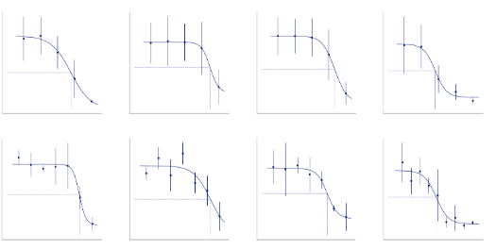
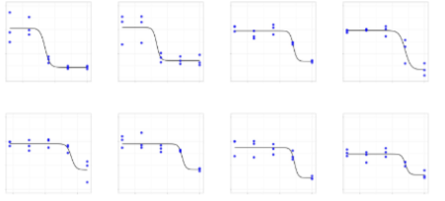
Curve generation
Manually review obtained clusters and assign labels for curve quality
With these labels, train supervised model capable of classifying dose response curves by their quality
Use unsupervised learning to cluster dose curves based on visual similarity
Produce a dataset of dose response images
Python package - simplydrug
R package – dr4pl

Slide 6
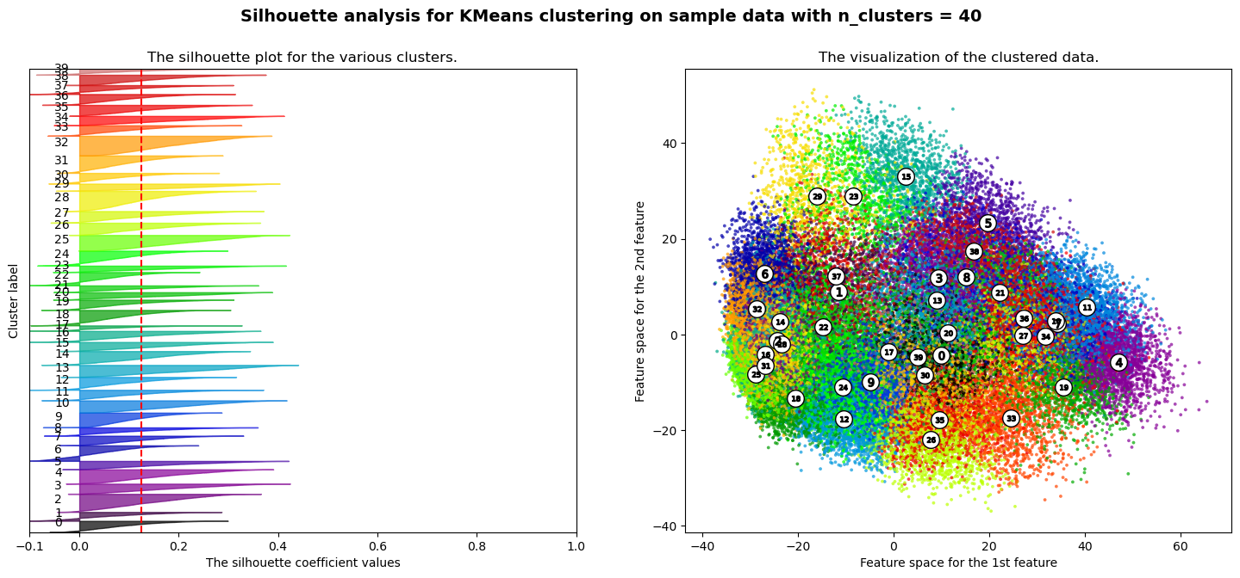
Obtain clusters
Manually review obtained clusters and assign labels for curve quality
With these labels, train supervised model capable of classifying dose response curves by their quality
Use unsupervised learning to cluster dose curves based on visual similarity
Produce a dataset of dose response images
VGG19 model for defining features
PCA for reducing number of features
KMeans for clustering
Silhouette analysis for judging clusters

Slide 7
Examples of clusters with assigned labels
Manually review obtained clusters and assign labels for curve quality
With these labels, train supervised model capable of classifying dose response curves by their quality
Use unsupervised learning to cluster dose curves based on visual similarity
Produce a dataset of dose response images
“Good”
“Mediocre”
“Bad”
“No Response”

Slide 8
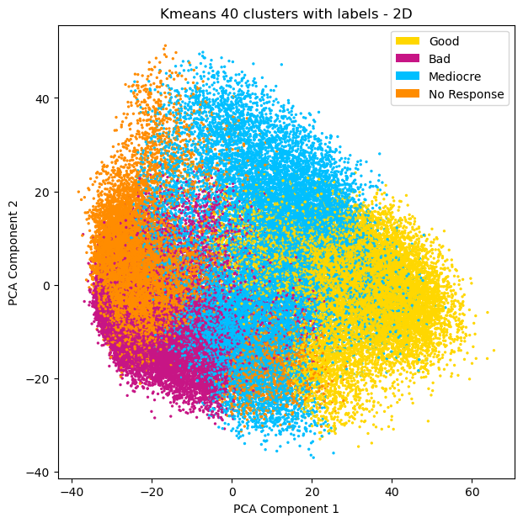
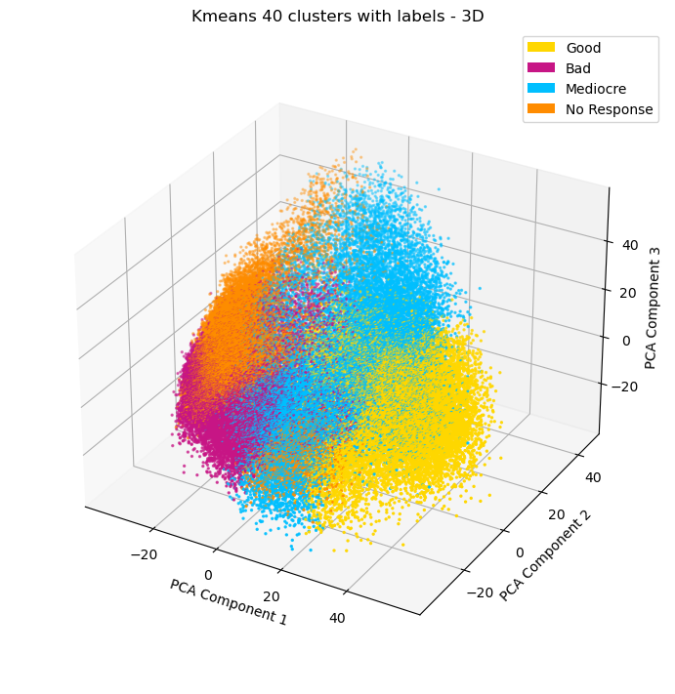
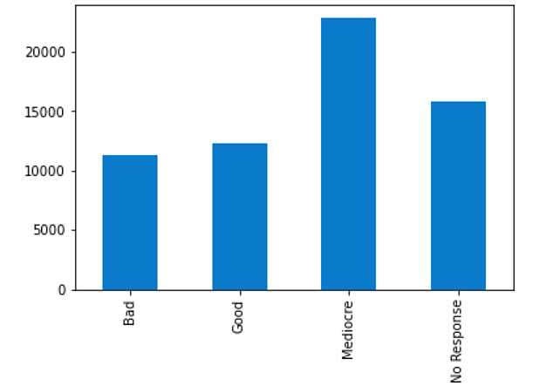
Visualization of labelled clusters
Manually review obtained clusters and assign labels for curve quality
With these labels, train supervised model capable of classifying dose response curves by their quality
Use unsupervised learning to cluster dose curves based on visual similarity
Produce a dataset of dose response images

Slide 9
Evaluation of models
Manually review obtained clusters and assign labels for curve quality
With these labels, train supervised model capable of classifying dose response curves by their quality
Use unsupervised learning to cluster dose curves based on visual similarity
Produce a dataset of dose response images
Model | Accuracy | Balanced Accuracy | Weighted Precision | Weighted Recall | Weighted F1 Score
Random Forest | 0.8693 | 0.8579 | 0.8696 | 0.8693 | 0.8687
Decision Tree | 0.8005 | 0.7901 | 0.8081 | 8005 | 0.8008
Voting | 0.8258 | 0.8146 | 0.8272 | 0.8258 | 0.8259
Stacking | 0.8379 | 0.8259 | 0.8377 | 0.8379 | 0.8371
Extra Tree | 0.8551 | 0.8433 | 0.8551 | 0.8551 | 0.8544
Ada Boost | 0.8045 | 0.7890 | 0.8049 | 0.8045 | 0.8030

Slide 10
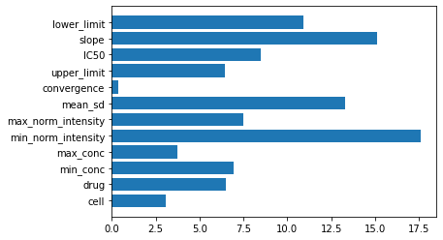
Random Forest
Manually review obtained clusters and assign labels for curve quality
With these labels, train supervised model capable of classifying dose response curves by their quality
Use unsupervised learning to cluster dose curves based on visual similarity
Produce a dataset of dose response images

Slide 11
Summary
VGG19, PCA, and Kmeans clustering was successfully used to generate dose curve clusters based on curve quality to create a labelled dataset for the development of a supervised learning model
Supervised learning performed well at classifying dose response curves
Various models performed similarly well, with random forest achieving the highest scores across a number of evaluation metrics
Top features that predicted curve classification were the minimum intensity value, standard deviation, and slope of the curve
Conclusion: we have successfully developed a curve classification model which can be utilized to reduce burdensome manual review of dose response curves

